Slide 1
Comprehensive Digital Marketing
Project Work

Slide 2

Part 1: Brand study, Competitor Analysis & Buyer’s/Audience’s Persona
COMPANY/TOPIC for project: APOLLO HOSPITALS
Research Brand Identity: Study the brand's mission, values, vision, and unique selling propositions (USPs).
Brand Colours: Teal blue and Saffron
LOGO:
Mission/Values:
Our Mission
We are committed to the achievement and maintenance of excellence in education, research and healthcare for the benefit of humanity”. Tender Loving Care is a way of life at Apollo Hospitals.
USP:
The cornerstones of Apollo's legacy are its unstinting focus on clinical excellence, affordable costs, modern technology and forward-looking research & academics.
Tagline : Your Greatest Wealth is Your Health

Slide 3
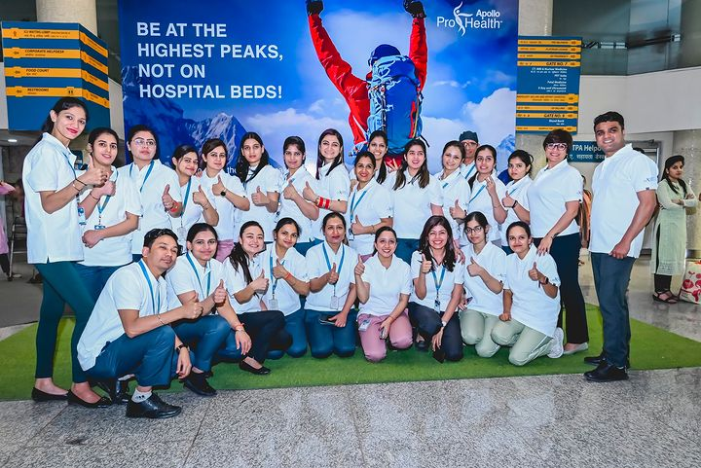
Part 1: Brand study, Competitor Analysis & Buyer’s/Audience’s Persona
COMPANY/TOPIC for project: APOLLO HOSPITALS
Brand Messaging: Informative & Awareness
https://www.instagram.com/p/CrQeevuKPAG/?utm_source=ig_web_copy_link&igshid=MzRlODBiNWFlZA==
Tagline: India, let’s be #BeProHealth

Slide 4
Part 1: Brand study, Competitor Analysis & Buyer’s/Audience’s Persona
Competitor Analysis: Select three competitors operating in the same industry or niche as the chosen brand, examine their USPs and online communication.
Competitor 1: Aster DM Healthcare Ltd
https://www.asterdmhealthcare.com/
USP: clinical excellence of our doctors, advanced medical technologies, patient-centric care and uncompromising integrity
Online communication : Provided toll free number and chat box
Competitor 2: Dr. Agarwal's Eye Hospital Ltd
https://www.dragarwal.com/
USP : Dr. Agarwal’s eye hospital with best eye specialist and 150+ hospitals in India providing best eye disease treatment since 1957.
Online Communication : Provided official website URL and chat box
Competitor 3: ANG Lifesciences India Ltd.
https://anglifesciences.com/
USP : A WHO GMP CERTIFIED COMPANY​​ ANG Lifesciences is a fast growing organization with an ultra modern, fully integrated, dedicated injectable Manufacturing Facility
Online Communication : Provided contact number and email

Slide 5
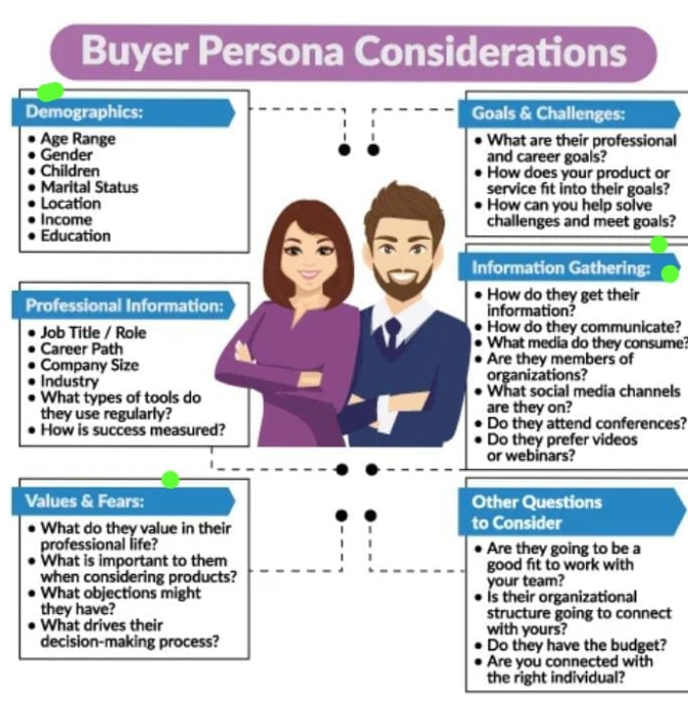

Part 1: Brand study, Competitor Analysis & Buyer’s/Audience’s Persona
Buyer's/Audience's Persona: Clearly define the target audience for the chosen brand. Consider demographics, psychographics, behaviors, and interests.
APOLLO HOSPITALS
Demographics :
Age Range : All Age Groups
Gender : All
Marital Status : Both ( married/unmarried )
Location : Over all World
Information Gathering :
How do they get their information : community
Platforms, You tube Ads, FB & Instagram Ads
Values / Fears :
compassion, respect for persons, commitment to integrity and ethical practice, excellence, and justice. / Some people have a family history of anxiety and specific fears.

Slide 6
Part 2: SEO & Keyword Research
SEO Audit: Do an SEO audit of the brands website
Keyword Research: Define Research Objectives, Brainstorm Seed Keywords, Utilize Keyword Research Tools (SEMrush or Moz Keyword Explorer),Analyze Competitor Keywords, Long-tail Keyword Exploration (specific, longer phrases) that align with the research objectives and have lower competition but higher conversion potential.
On page Optimization: Meta Tag optimization & content optimization
Reflect on the process of conducting keyword research and the SEO recommendations provided.
Document the challenges faced during the research and analysis phase, as well as the key insights gained from the keyword research process.

Slide 7
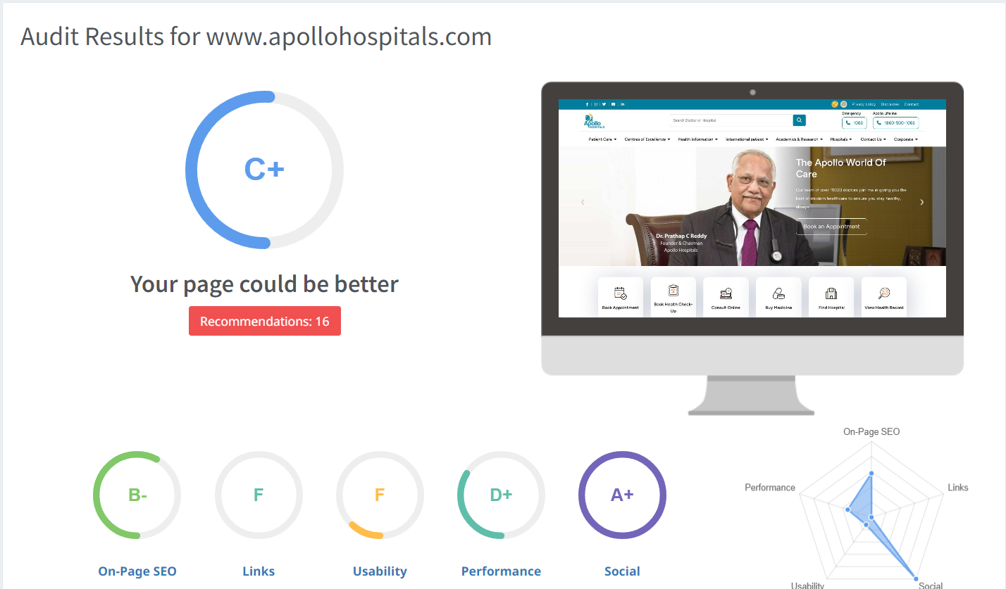
Part 2: SEO & Keyword Research
SEO Audit: Do an SEO audit of the brands website.

Slide 8
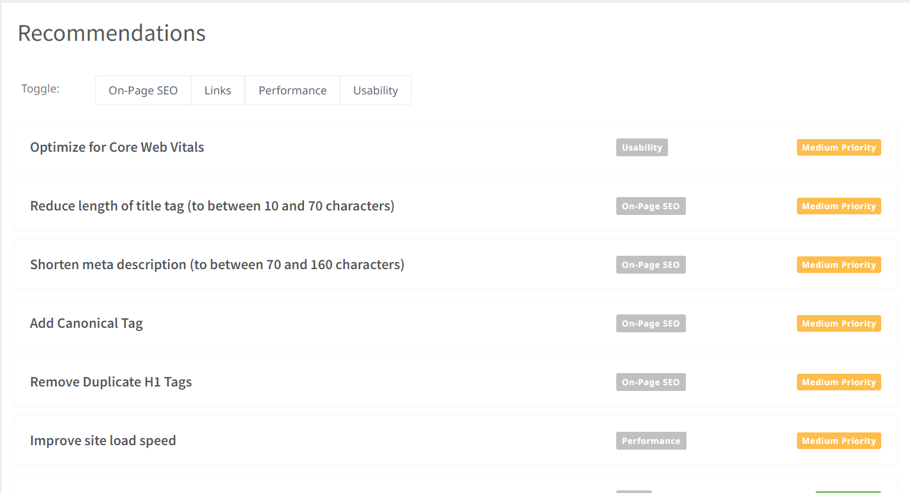
Part 2: SEO & Keyword Research
SEO Audit: Do an SEO audit of the brands website.

Slide 9
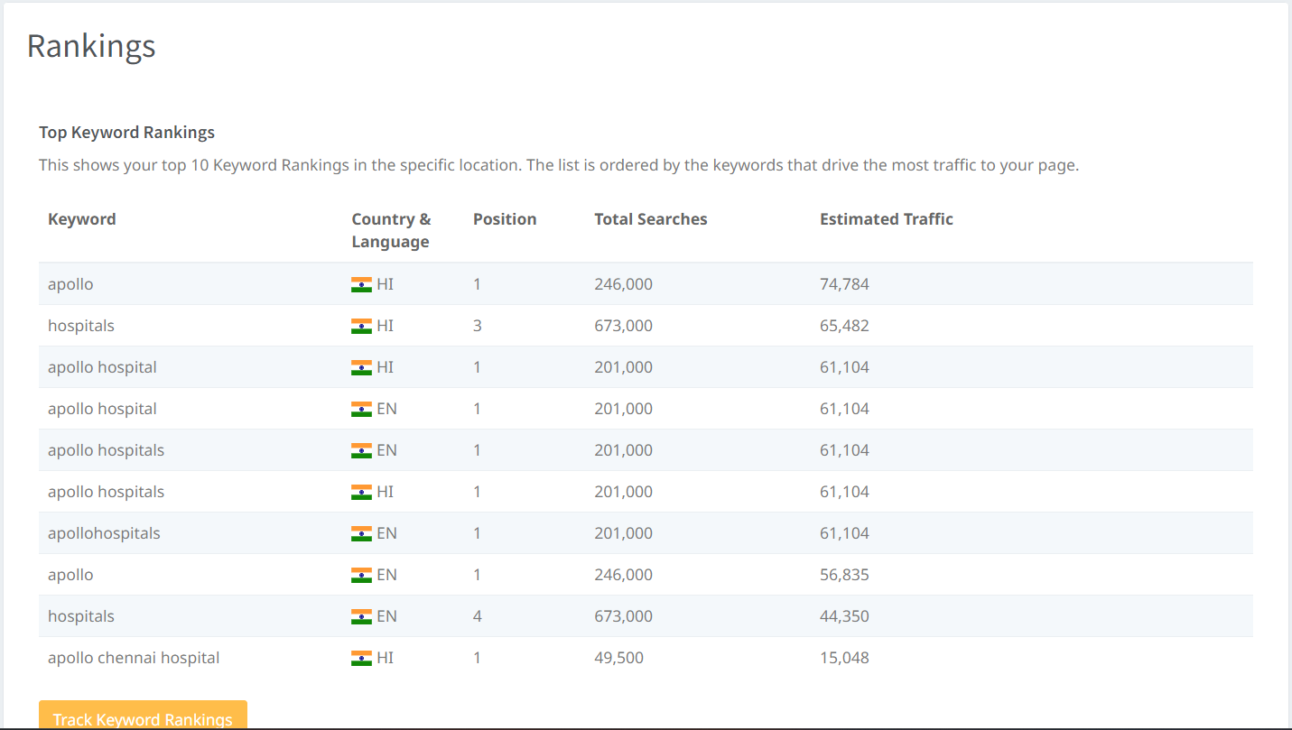
SEO Audit: Do an SEO audit of the brands website.
Summary : The goal of Search Engine Optimization is to improve the ranking of your website for particular keywords to drive more clicks and traffic to your site. The Top Keyword Rankings check shows you the keywords that your site is currently ranking for, ordered by those that are likely driving the most traffic to your site due to a combination of high Search Volume and high ranking. Note, this data is a snapshot and may be several weeks old in some cases.

Slide 10
HEALTHCARE SERVICE
Keyword | Avg. monthly searches | Competition
healthcare services | 5000 | Low
health insurance | 500000 | Medium
care health insurance | 500000 | Low
Meta Title
Choose the Which one is better healthcare |  |  | 63
Meta Description
Apply for the best healthcare service |  |  | 74
MEDICAL TREATMENTS
Keyword | Avg. monthly searches | Competition
homeopathic medicine | 50000 | Low
ayurvedic medicine | 50000 | High
back pain relief | 500000 | Low
Meta Title
Find the best TREATMENT for homeopathic ,ayurvedic ,back pain |  |  | 69
Meta Description
Apply now for the best medical treatment |  |  | 91

Slide 11
MULTISPECIAL
Keyword | Avg. monthly searches | Competition
specialties | 50000 | Low
internal medicine | 5000 | Low
critical care | 5000 | Low
Meta Title
We introducing new specialties health treatments |  |  | 71
Meta Description
Enjoy the Benefits of new specialties of our treatments choose best one for your interest |  |  |  |  |  | 108
DOCTER & PHYSICIANS
Keyword | Avg. monthly searches | Competition
doctors and physicians | 50 | Low
doctor | 500000 | Low
doctors near me | 500000 | Low
Meta Title
Check the charges of consultant doctor fee and more servece |  |  | 71
Meta Description
Choose the futured useful for your health which one is the best docters |  |  | 72

Slide 12
MEDICAL TOURISM
Keyword | Avg. monthly searches | Competition
medical value travel | 500 | Low
health tourism agency | 50 | Medium
medical tourism services | 50 | Low
Meta Title
Explore your new Medical tourism and choose the best |  |  |  | 70
Meta Description
Check the Medical tourism for your interest agency , services etc |  |  |  | 82

Slide 13
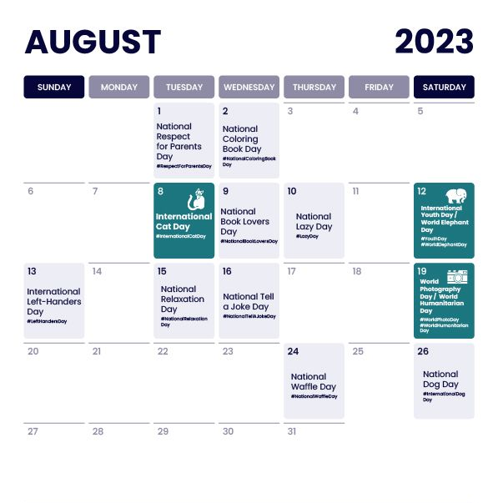
Part 3: Content Ideas and Marketing Strategies
Content Idea Generation & Strategy: Create a content calendar for the remaining month of July by brainstorming content themes, exploring various formats like blog posts, videos, infographics, podcasts, and interactive quizzes, and scheduling publication dates mainly on Facebook & Instagram. And include the strategy, aim and the idea behind these posts and story
Content Calendar Example (Try creating a table for the month of July)

Slide 14


Part 3: Content Ideas and Marketing Strategies
Reflect on the content ideas and marketing strategies process, discussing the challenges encountered and lessons learned.
Date : 17th august 2023
Exploring cutting-edge medical technologies: Create informative content
highlighting the latest medical innovations and Targeted
content distribution: Identify and reach out to healthcare professionals,
researchers.
Date : 18th august 2023
Explainer Videos: Create short, engaging videos that explain the key
features and benefits of the Apollo Healthcare policy. And Targeted
Digital Advertising: Utilize social media platforms and search engines
to reach the right audience with targeted advertisements promoting
the Apollo Healthcare policy.

Slide 15

Part 3: Content Ideas and Marketing Strategies
Reflect on the content ideas and marketing strategies process, discussing the challenges encountered and lessons learned.
Date : 21st august 2023
Expert Articles and Blog Posts: Publish articles written by
healthcare professionals and wellness experts on various
topics related to nurturing health, including nutrition,
fitness, mental health, and preventive care.
And Audience Research: Conduct thorough research
to understand the target audience's preferences, pain
points, and interests related to health and wellness.

Slide 16
Creating content ideas and devising effective marketing strategies is a dynamic process that involves continuous learning and adaptation. Throughout this journey, several challenges and valuable lessons can be encountered. 1.Understanding the Audience: One of the primary challenges is comprehending the target audience's preferences, needs, and pain points. 2. Generating Unique Ideas: Coming up with fresh and innovative content ideas can be difficult, especially in saturated markets. 3. Consistency and Quality: Maintaining a consistent flow of high-quality content can be demanding. Setting up an editorial calendar and adhering to a content creation schedule helps in maintaining quality and meeting deadlines. 4. Content Promotion: Even the best content may not gain traction without proper promotion. Crafting effective marketing strategies to reach the target audience across various channels is crucial for success. 5. Collaboration: Collaborating with influencers or other brands can amplify the reach of content and strengthen marketing efforts. The content ideas and marketing strategies process is an iterative and learning-oriented journey

Slide 17
Part 4: Content Creation and Curation (Post creations, Designs/Video Editing, Ad Campaigns over Social Media and Email Ideation and Creation)
Post Creation:
Select Content Categories: Identify three different content formats relevant to the chosen topic or industry. Research and Brainstorm: Research trending topics, industry news, or audience interests within each category. Brainstorm ideas for social media posts that align with each category. Do note that 1 content format has to be video and additionally 3 stories/status are to be created.
Format 1 Blog article
Format 2 Video
Format 3 Creative

Slide 18

Part 4: Content Creation and Curation (Post creations, Designs/Video Editing, Ad Campaigns over Social Media and Email Ideation and Creation)
Format 1 Blog article
Aim : To promote newly launched Advancing
Medical Technology and Research
Date : 17th august 2023
Idea : Apollo hospital has launched new
Advancing Medical Technology and Research
Topic : Advancing Medical Technology and Research :

Slide 19

Part 4: Content Creation and Curation (Post creations, Designs/Video Editing, Ad Campaigns over Social Media and Email Ideation and Creation)
Format 2 Video
Aim : Apollo Healthcare policy to reach everyone
Date : 18th august 2023
Idea : Apollo hospital has launched new healthcare policy its become to use everyone
Topic : Healthcare policy for Apollo hospital :

Slide 20

Part 4: Content Creation and Curation (Post creations, Designs/Video Editing, Ad Campaigns over Social Media and Email Ideation and Creation)
Format 3 Creative
Title :"Transforming Healthcare: Apollo Hospitals’
Journey of Excellence“
Aim :"Apollo Hospital: Nurturing Health, Embracing Life“
Date : 21st august 2023
Idea : Apollo Hospital: The Brand Identity ,Nurturing
Health , Embracing Life , Patient-Centric Care
Topic : Nurturing Health, Embracing Life

Slide 21
Part 4: Content Creation and Curation (Post creations, Designs/Video Editing, Ad Campaigns over Social Media and Email Ideation and Creation)
Instagram Story
Utilize the Stories feature on Instagram for three consecutive days. Share behind-the-scenes glimpses, polls, quizzes, or sneak peeks etc to encourage audience participation. Once uploaded use the story highlight feature on Instagram and save the 3 story with an appropriate name for each. Note: Once done monitor the performance of the posts and Stories using the insight tool and analyze the engagement metrics (likes, comments, shares, impressions, etc.). Based on the analysis, mention the strategies and areas for improvement.

Slide 22
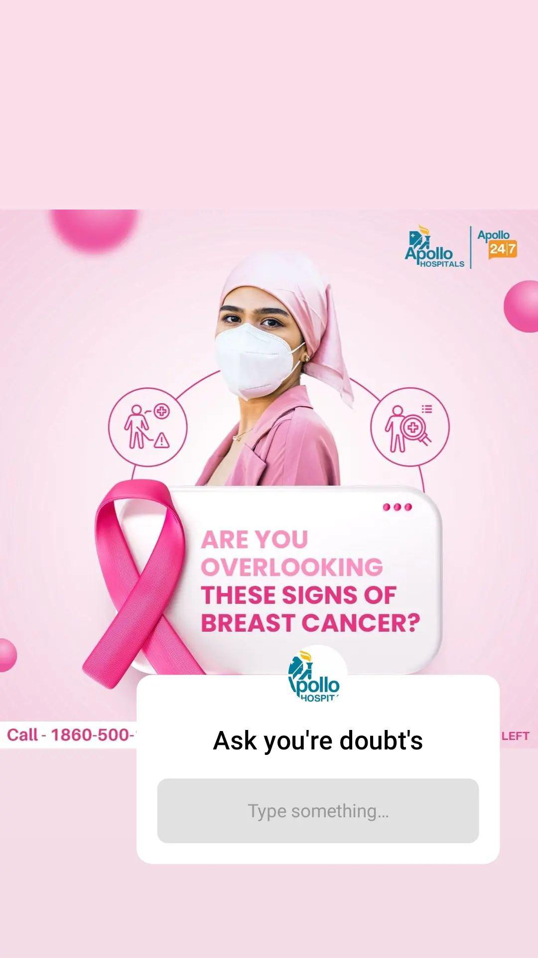

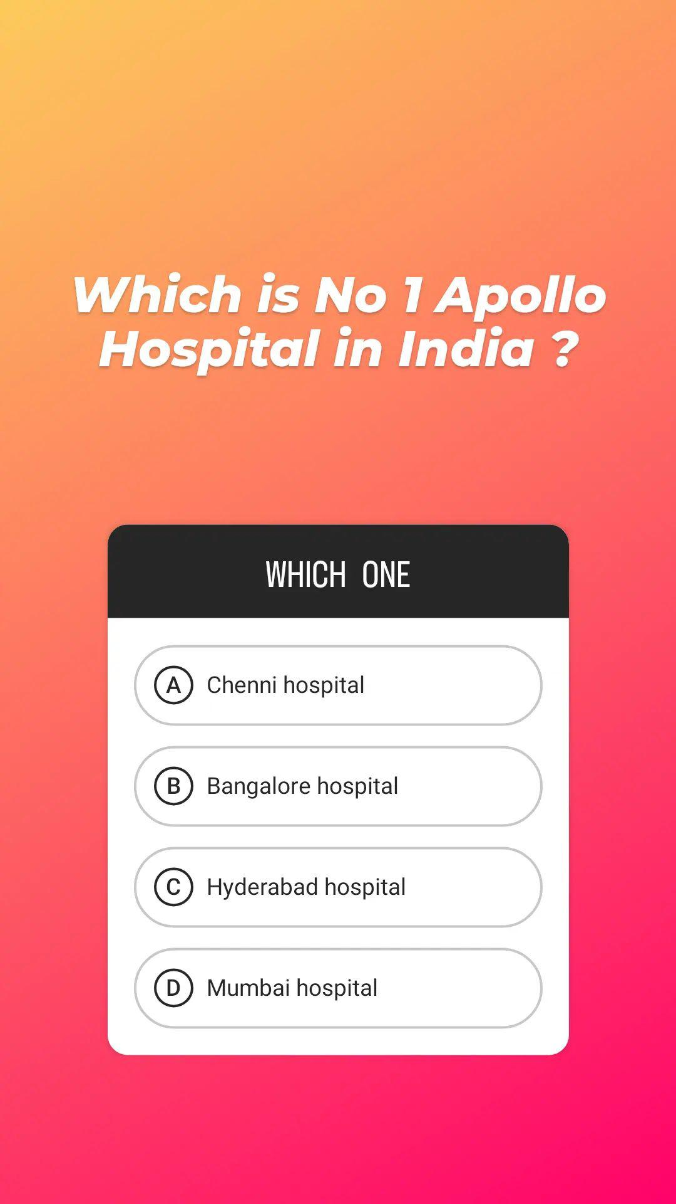
Part 4: Content Creation and Curation (Post creations, Designs/Video Editing, Ad Campaigns over Social Media and Email Ideation and Creation)
Instagram Story

Slide 23

Part 4: Content Creation and Curation (Post creations, Designs/Video Editing, Ad Campaigns over Social Media and Email Ideation and Creation)
Designs/Video Editing
Design Tools Familiarization (use Canva for creating visually appealing graphics)
Video Creation: Utilize VN or any video editor of your choice to create videos related to the chosen topic.

Slide 24
Part 4: Content Creation and Curation (Post creations, Designs/Video Editing, Ad Campaigns over Social Media and Email Ideation and Creation)
Social Media Ad Campaigns
Ad Campaigns over Social Media:
Come up with 3 ad campaigns each covering one of the mentioned goals: brand awareness, driving website traffic, or generating leads

Slide 25
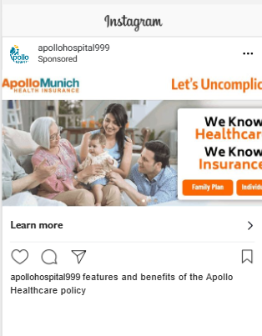
Part 4: Content Creation and Curation (Post creations, Designs/Video Editing, Ad Campaigns over Social Media and Email Ideation and Creation)
Social Media Ad Campaigns
Brand awareness campaign:
Targeting: Location: India, All genders,
Interests: Hospitality industry, Hospitality management studies or Foodie
https://www.instagram.com/p/Cvbq_YaPtxG/?utm_source=ig_web_copy_link&igshid=MzRlODBiNWFlZA==

Slide 26
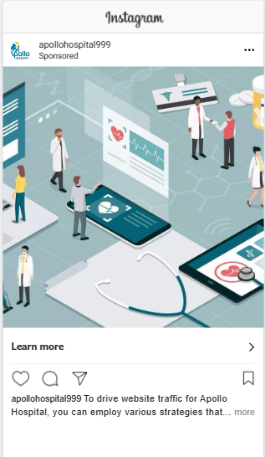
Part 4: Content Creation and Curation (Post creations, Designs/Video Editing, Ad Campaigns over Social Media and Email Ideation and Creation)
Social Media Ad Campaigns
Driving website traffic:
Targeting : Location: India, All genders,
Interests: Clinical trial (health & medical),
General Hospital (television show), Laboratory (science)
https://www.instagram.com/p/CvboQQCPZ8S/?utm_source=ig_web_copy_link&igshid=MzRlODBiNWFlZA==

Slide 27
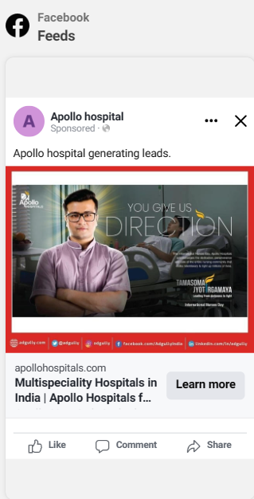
Part 4: Content Creation and Curation (Post creations, Designs/Video Editing, Ad Campaigns over Social Media and Email Ideation and Creation)
Social Media Ad Campaigns
Generating leads :
Targeting: Location: India, All genders,
Interests: , General Hospital , Health & wellness , Medicine.

Slide 28
Part 4: Content Creation and Curation (Post creations, Designs/Video Editing, Ad Campaigns over Social Media and Email Ideation and Creation)
For every campaign clearly define:
Advertising Goals: increasing brand awareness, driving website traffic, or generating leads.
Audience Targeting: Define the target audience for the ad campaigns based on demographics, interests, and behavior.
Ad Creation: Create visually appealing ad creatives, compelling ad copy and relevant call-to-action.

Slide 29
Part 4: Content Creation and Curation (Post creations, Designs/Video Editing, Ad Campaigns over Social Media and Email Ideation and Creation)
Email Ad Campaigns
Ad Campaigns for email marketing:
Come up with 2 email ad campaigns with the mentioned goals: brand awareness & generating leads

Slide 30
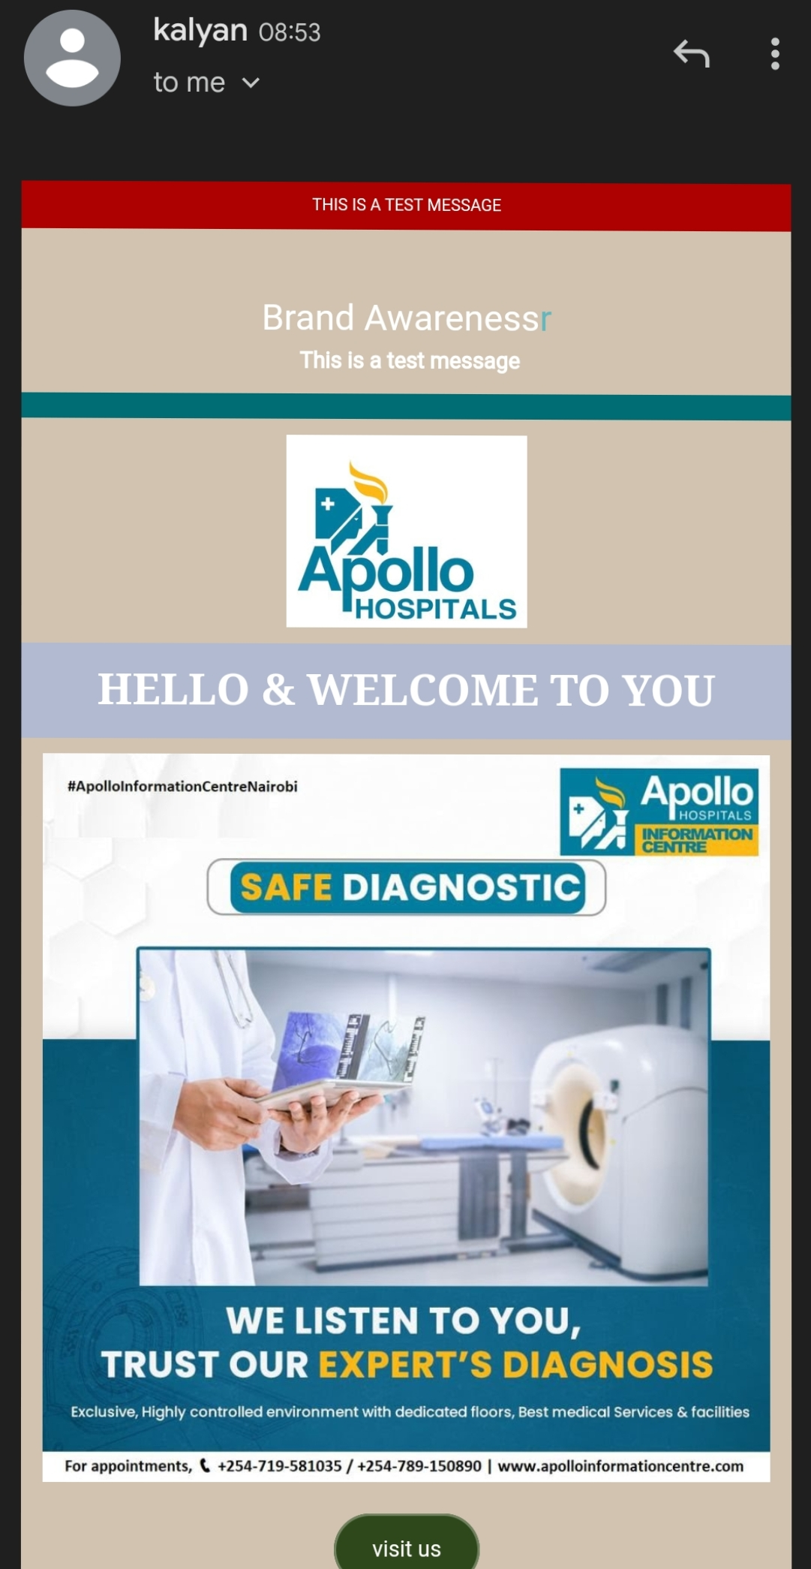
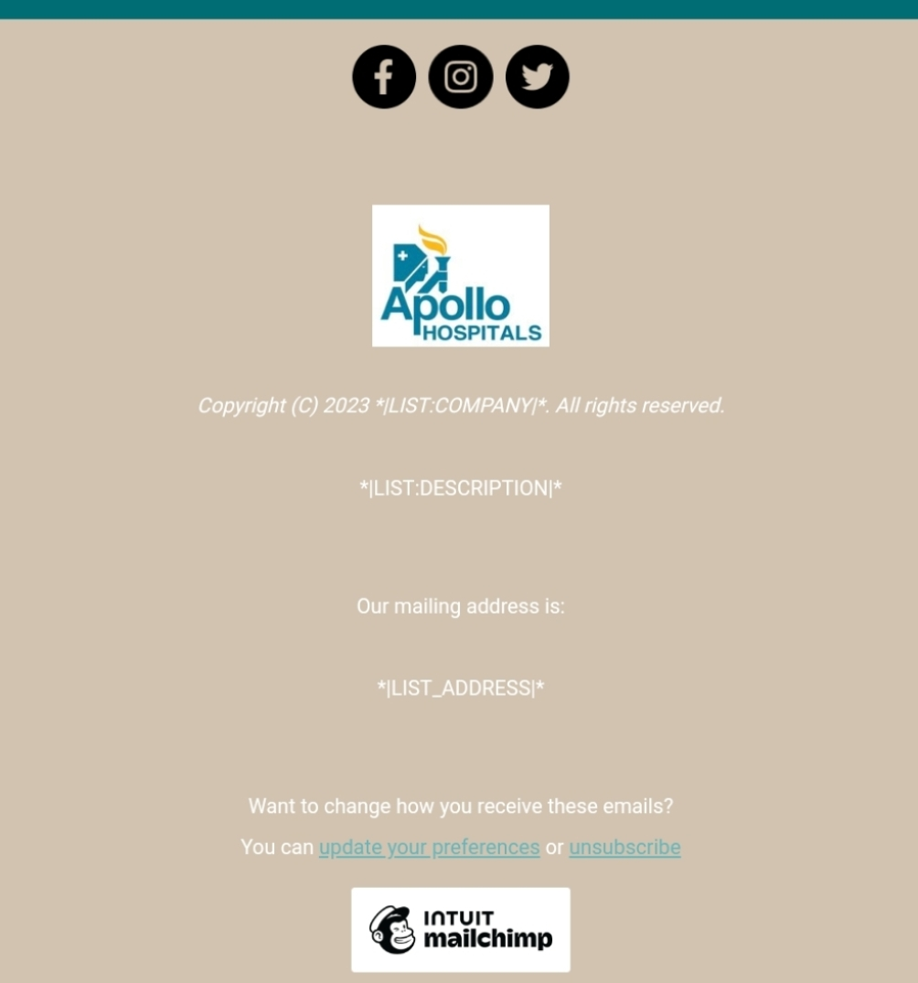
Email Ad Campaign 1 - Brand Awareness
(insert emailer image)

Slide 31
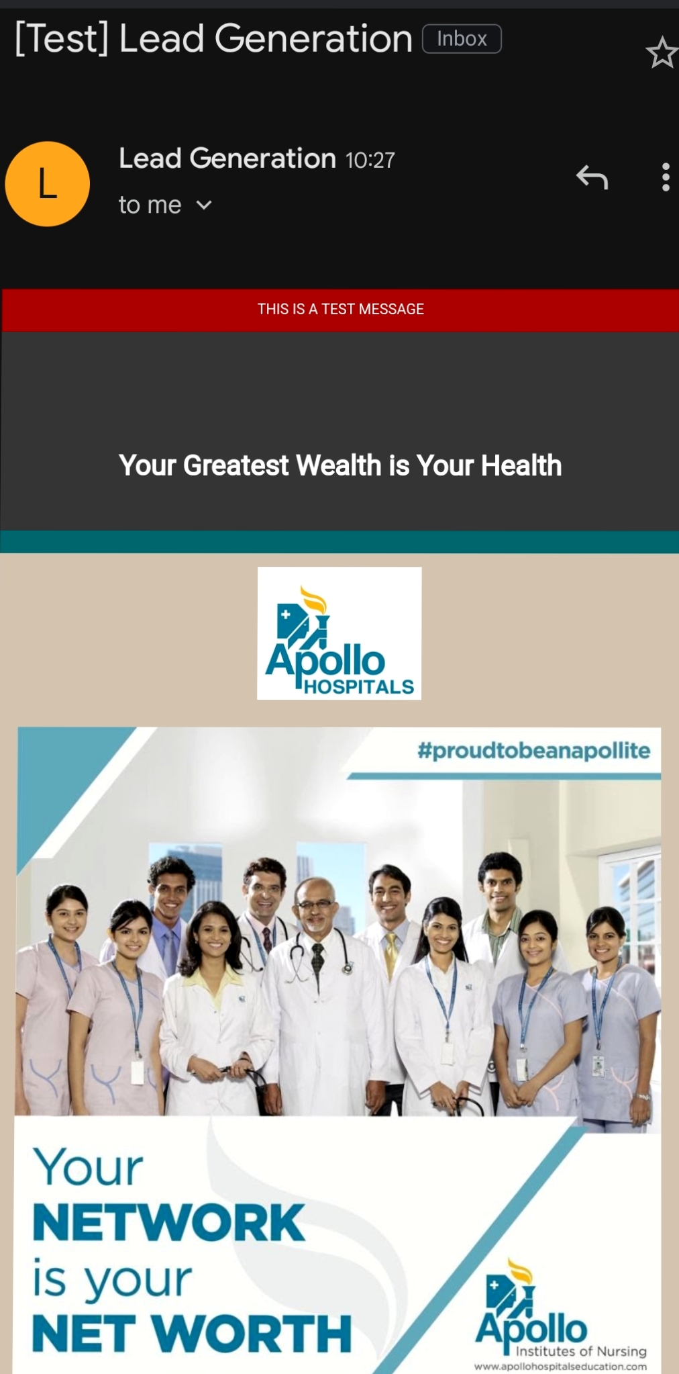
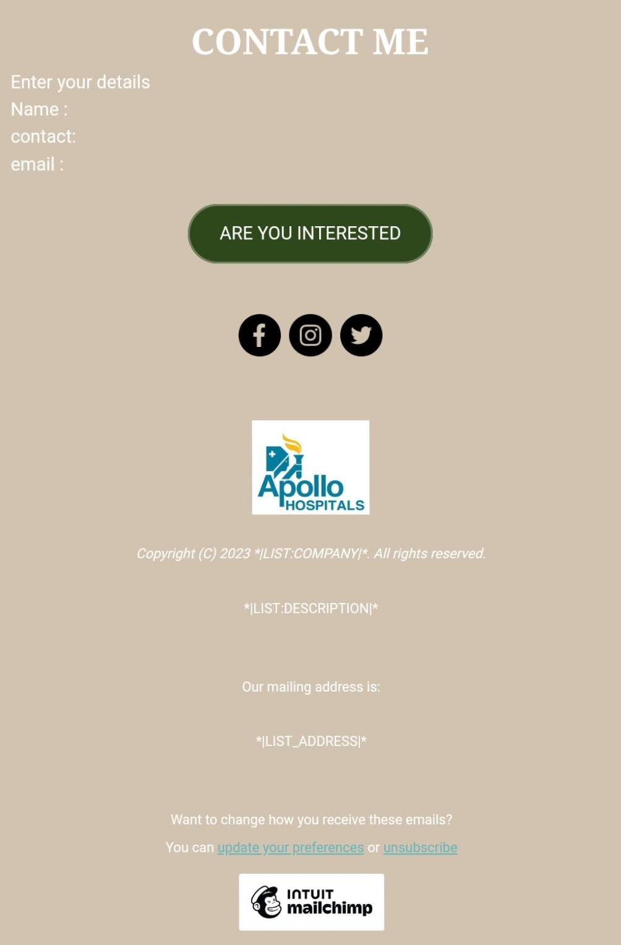
Email Ad Campaign 2 - Lead Generation
(insert emailer image)

Slide 32
Part 4: Content Creation and Curation (Post creations, Designs/Video Editing, Ad Campaigns over Social Media and Email Ideation and Creation)
Reflect on the content creation and curation process, discussing the challenges faced and lessons learned.
1. Consistency is Key: Maintaining a consistent tone, style, and frequency of content across platforms helps reinforce brand identity and improves audience recall.
2.Visual Appeal: Eye-catching visuals, well-designed graphics, and professionally edited videos can significantly enhance the impact of content and ad campaigns.
3. A/B Testing: Regularly conducting A/B + tests for ad campaigns and email subject lines allows for data-driven optimization and better results.
4.Know our Audience: Understanding the target audience's interests, pain points, and preferences is fundamental in creating relevant and engaging content.
5. Engage with the Audience: Responding to comments, messages, and feedback from the audience fosters a sense of community and builds trust.
6. Long-Term Approach: Content creation and marketing are not one-time endeavors. A long-term, strategic approach is necessary to build brand awareness and achieve sustainable growth.
In conclusion, content creation and curation, along with thoughtful design, video editing, and well-executed ad campaigns, play a pivotal role in a successful marketing strategy. By understanding the challenges and incorporating the lessons learned, businesses can create compelling content that resonates with their target audience and drives results

